Slide 1

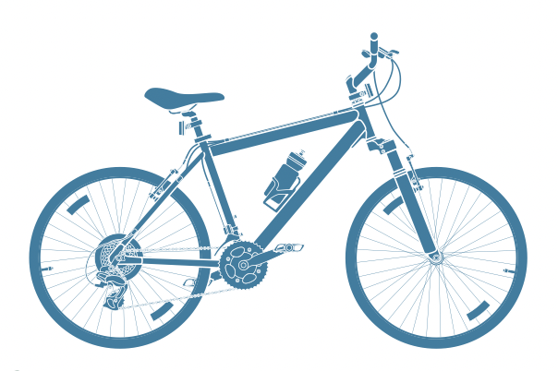
FUTURE OF CYCLE INDUSTRY IN INDIA
1. MAYAS MAHAJAN (21MBA7177)
2. SATYAJIT MOHAN (21MBA7145)
3. AMISHA GUPTA (21MBA7191)
4. KUDRAT (21MBA7135)
5. SADIQ ULLAH HAMDARD (21MBA7194)
6. MONICA(21MBA7152)
7. DEEKSHA SINGH (21MBA7188)
8. PRAJWAL SINGH (21MBA7149)
9. YASHBIR SINGH (21MBA7155)
10. HONEY ARORA (21MBA7160)

Slide 2

INTRODUCTION OF CYCLE INDUSTRY
The bicycle Industry took birth in 1938 when it was decided by the Indian Government to manufacture them to be used by British and Allied forces.
In 1943, Cycle Manufacturers’ Association was formed.
Bicycle penetration in India started only after the year 1960.
Interestingly, the Indian Government introduced voluntary price control on bicycles. By 1970, India became the fifth largest producer of bicycles in the world.

Slide 3
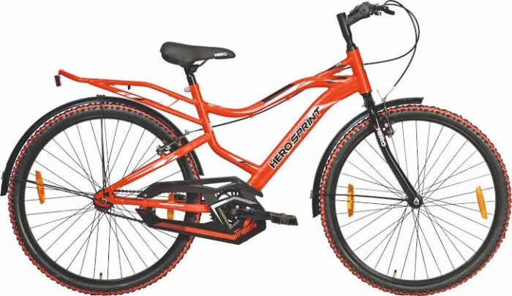
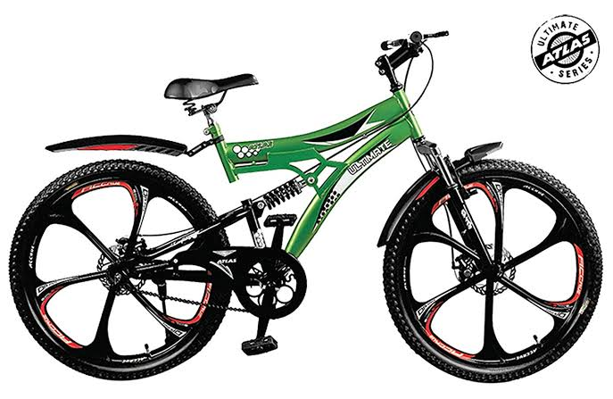
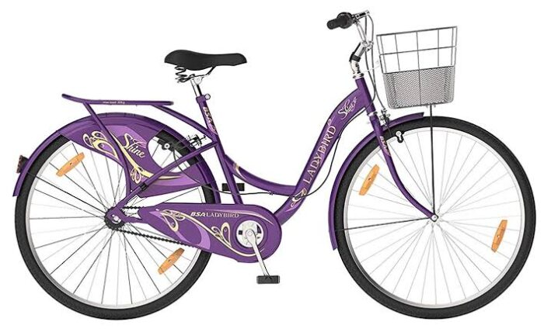
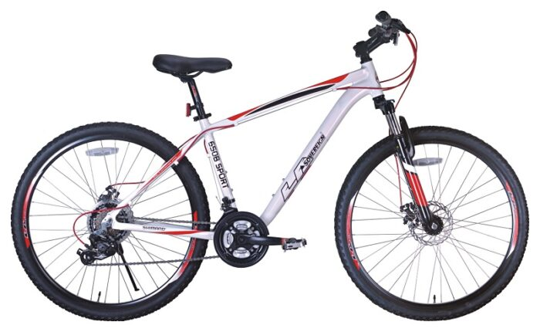
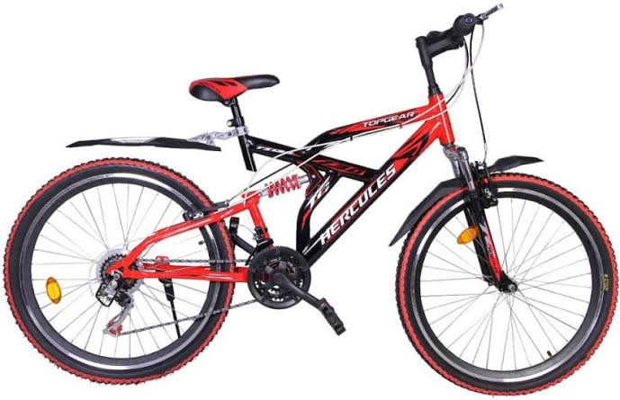
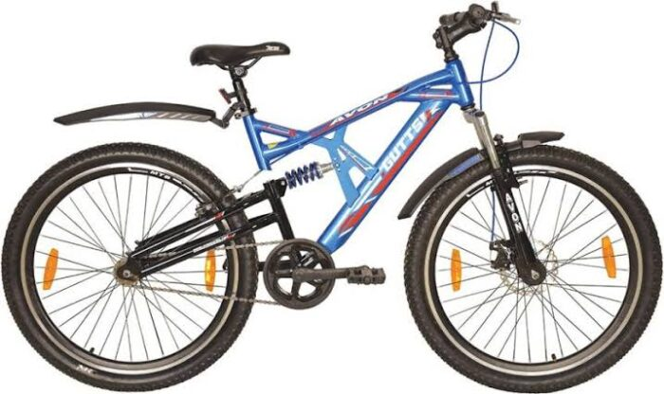
Top 10 Bicycle Brands in India 2020
1) Hero
2) Atlas
3) Avon
4) Hercules
5) La-sovereign
6) BSA Ladybird
7) Firefox
8) Montra
9) Mach City
10) Road Master

Slide 4
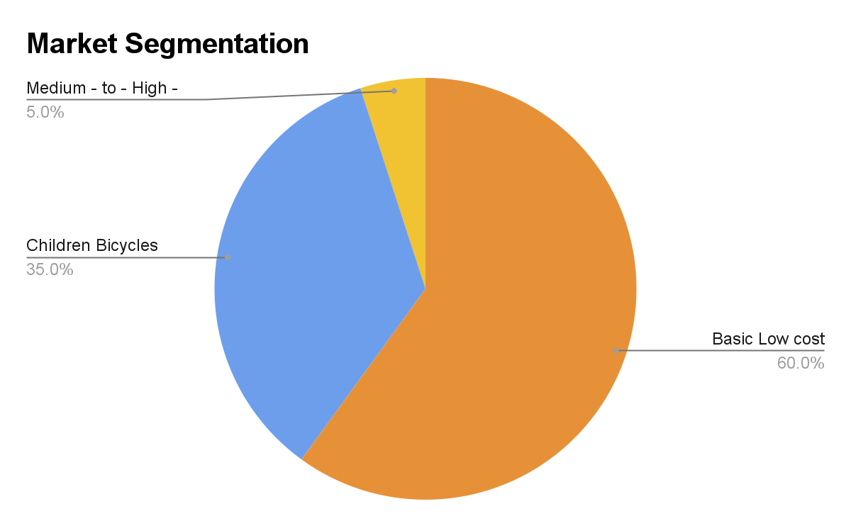
Branding and Marketing - Top 5 Bicycle selling companies in India
Pricing Strategy
Brands | Roadsters | Children Bikes | Highend Bikes
Hero | 5000 - 10000 | 3000 - 6000 | 14000 - 1.35Lk
Atlas | 3000 - 7000 | 2000 - 5000 | 10000 - 25000
Hercules | 4000 - 12000 | 2000 - 6000 | 10000 - 68000
La sovergin | 6000 - 12000 | 5000 - 10000 | 12000 - 3lk
BSA | 5000 - 9000 | 1500 - 6000 | 10000 - 2lk

Slide 5

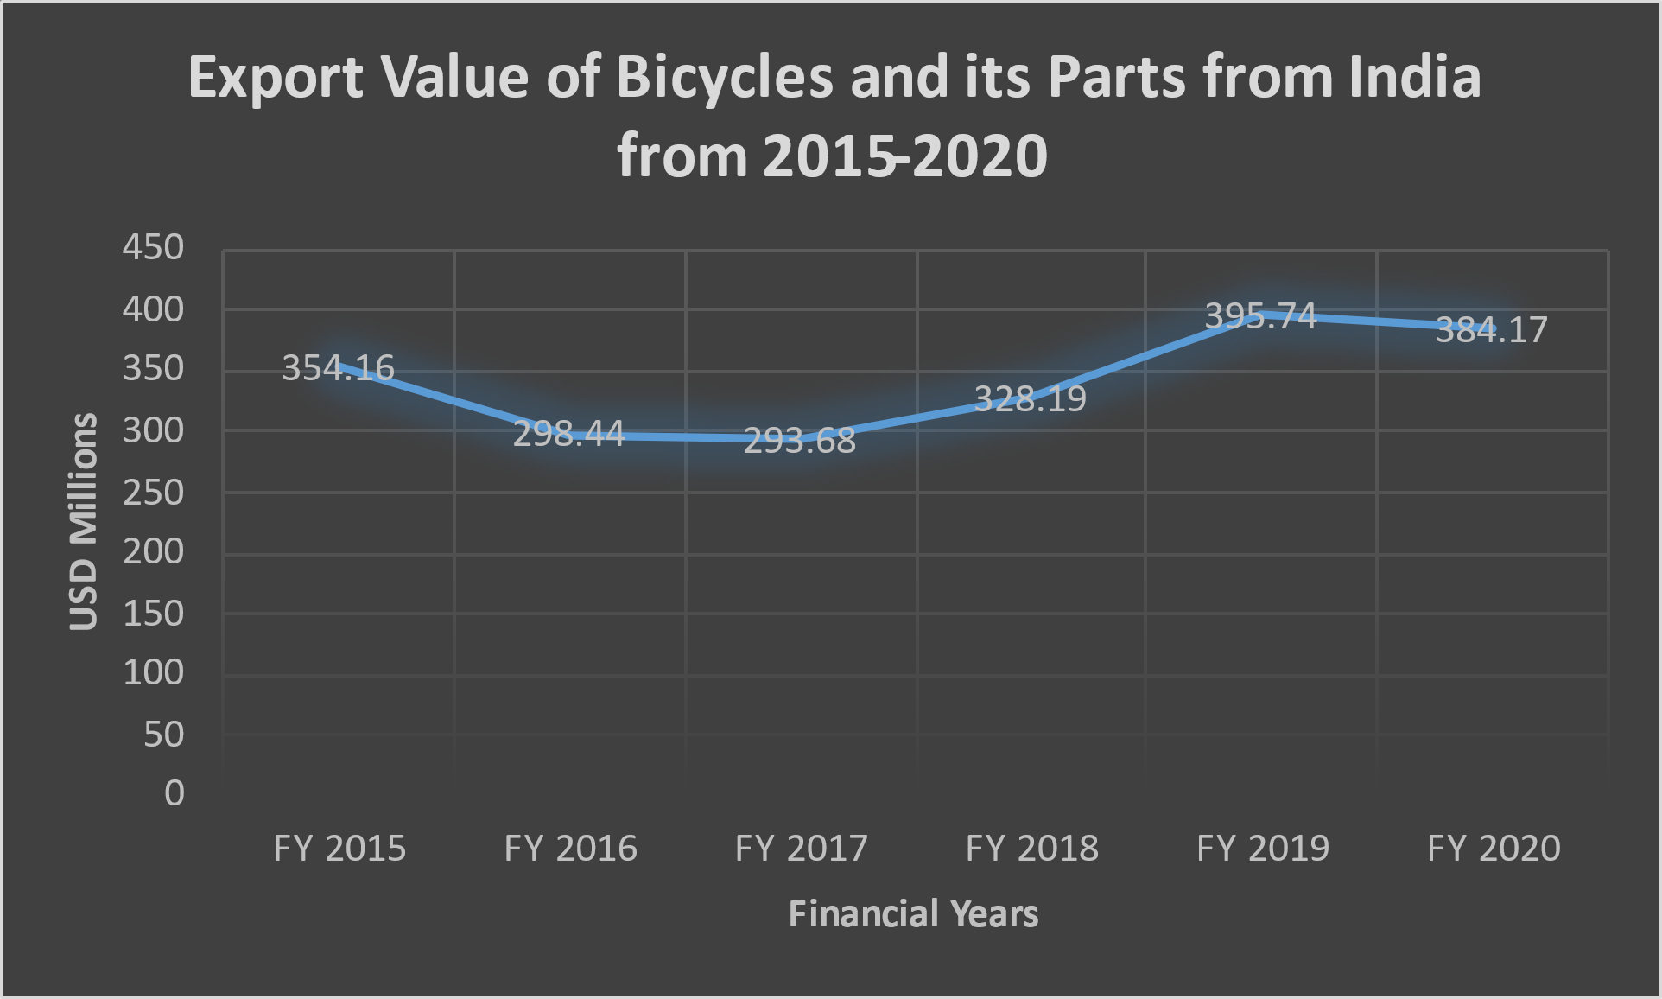
Cycle Production in India

Slide 6

Segments of Cycle Sales in India

Slide 7
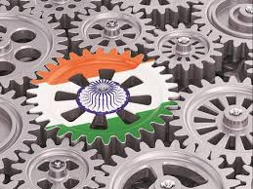
India’s Bicycle Market on a Fast Track Amid Pandemic
India’s cycle industry is the 2nd largest in the world.
India is the 3rd largest consumer of bicycles.
15 to 22 million units manufactured every year Turnover of Rs. 5,000-7,000 crore.
Set to grow at a CAGR* of 8.6% between 2017-2030
Cost of one bicycle varies from Rs.6,000 to Rs 600,00.
Cycling for short distancing can earn an annual benefit of Rs. 1.8 trillion to the Indian economy, according to the Ministry of Housing and Urban Affairs.
A total of 41,80,945 bicycles have been sold in the country in five months from May to September 2020, according to the All India Bicycle Manufacturers Association (AICMA).

Slide 8
Comparison of Imports and Exports of Bicycles and Parts in India

Slide 9

Growth of Bicycle Industry in India Over The Years

Slide 10

BICYCLE PRODUCTION OF SELECTED COUNTRIES

Slide 11

FUTURE ANALYSIS OF BICYCLE INDUSTRY IN INDIA
According to research done by market research future, the bicycle global market is going to hit 63474.2$ million between 2018 and 2030. Due to the COVID-19 crisis gone move towards bicycles due to health issues which will attract huge consumers According to research done by Grand View research, the global market size is valued at 54.44 used according to the survey in 2020.
This survey says that the growth in traffic will leads consumers to divert to electric bicycles which are cost friendly. According to research done by PERSISTENCE market research, the bicycle industry producing hybrid bikes, for the comfort and attract consumers towards them, it also highlights the point of traffic jam. Nearly 24% growth can be found in the bicycle industry in 2019. According to research done by Intrados global news wire, the global bicycle market has been grown by 5.02%.
This survey says that attractive features will attract new consumers globally. Nowadays, everyone wants a healthy lifestyle. According to research done by Order intelligence, this survey is predicting that the market will boost over 50% in 2025. Due, to corona, many new consumers have been added to the bicycle industry. The bicycle industry has a great scope in the future.

Slide 12


Slide 13


Slide 14


STRENGTHS
India also imports the majority of its raw materials from within the nation, such as steel tubes.
The industry has the potential to manufacture a low-cost roadster platform.
Focusing on labor-intensive production procedures.
The final product is extremely concentrated since it sources a considerable amount of its components from a huge number of small businesses.
Almost 90% of its exports go to other developing nations,
The replacement market alone to estimate to generate sales of 3 million bicycles in the not-too distant future.
The presence of a large number of vendors in one location has aided in the development of low cost infrastructure and just-in-time deliveries.
The industry has created a framework that is built on the usage of dependable and simple technologies. This has resulted in increased pricing utilization as well as waste reduction.

Slide 15
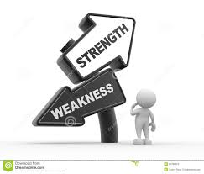
WEAKNESSES
The Indian bicycle market is just about 1% of the global market, thanks to low-cost, low-quality goods.
Even so, the Indian bicycle industry acknowledges that the value of its products must be increased unable to thrive in international markets.
Technology and quality improvements must be built into any aspect and facet of the bicycle.
Entrepreneurs' simple mechanical skills are best geared to copying/adapting rather than developing new inventions.
India has fallen behind other mature economies that are the optimum business of bicycles and parts, due to a lack of modern product production and the use of stronger and lighter metals such as aluminum alloy .

Slide 16

OPPORTUNITIES
Expanding Market Size and Changing Consumer Preferences
Increase in Consumer Disposable Income
Artificial Intelligence Advancements
Changing Technology Landscape

Slide 17

THREATS
US-China Trade Relations
Government Laws and Bureaucracy
Industry culture of sticky prices
Squeezing the Middle Class in the Developing Worlds
Growing Protectionism
Buyers' bargaining power is growing

Slide 18

CONCLUSION
The Indian bicycle has been facing several challenges in achieving export competitiveness. The industry mainly produces large models of steel roadster bicycles, children's bicycles, and a small, limited volume of premium bicycles.
The bicycles which were demanded in the global markets are aesthetically and technically more superior than those produced domestically, which are created from high-end materials, are of multiple speed setting and they require many special components which are often from the specific brands and even through the second-largest bicycle industry in the world is Indian bicycle industry in terms of volume, manufacturers have been facing several demand and supply related barriers when producing bicycles which are demanded globally.
They include the raw materials that have a lack of access to appropriate grades and forms at affordable prices mainly including aluminum alloy. To gain access to international markets and consumer confidence there is a need for international marketing and selling channel.

Slide 19
References:
https://www.indiatoday.in/business/story/india-s-bicycle-market-on-a-fast-track-amid-pandemic-1717273-2020-09-01
https://www.marketingmind.in/top-10-brands-bicycle-brands-in-india-2020/
https://www.businesstoday.in/latest/economy-politics/story/cycle-sales-in-india-double-in-last-5-months-amid-pandemic-275656-2020-10-14
https://aicma.org
Bicycle Industry in India and its Challenges A Case Study Puneeth B. R. 1, 2 & Nethravathi P. S.
India’s bicycle market on a fast track amid pandemic Aishwarya Paliwal,New Delhi,September 1, 2020,UPDATED: September 1, 2020 08:59 IS
Top 10 Bicycle Brands In India 2021[Updated]

Slide 20

Thank You!

